Slide 1
Basics of Nanofabrication
Keshab Sapkota
(krsapko@sandia.gov)
February 28, 3:30 - 4:30pm
1026/518 (CINT)
CINT Nanofabrication Workshop Series (CNWS)
SAND No. SAND2023-00047PE

Slide 2
CINT Nanofabrication Workshop Series (CNWS)
Goals: Help integration lab (IL) users community to
Smooth out learning curve for new users with no/little prior fabrication experience
Address fabrication bottlenecks for the users and minimize/avoid “rediscovering the wheel”
Discuss advanced fabrication topics with experts and learn from each other
Workshop Topics
Introductory Topics
Planning & design, fab process flow, sample handling, troubleshooting
Workshop Format
Presentation on the Topic
(30 minutes)
(30 min)
Group Discussion
(15 minutes)
Intermediate Topics
Lithography, chemical processes, etching, depositions, metrology, holistic approach, troubleshooting
New IL Users
Discussion on user’s fab issues (15 minutes)
Advanced Topics
Materials specific, device architecture specific, complex process flow, integration
Existing IL Users

Slide 3
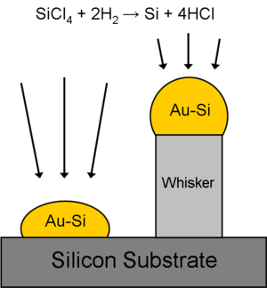
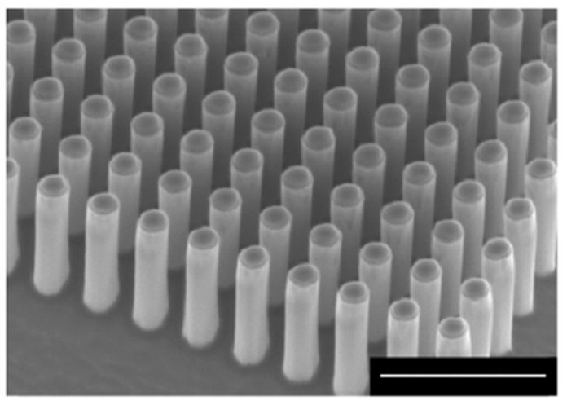
What is Nanofabrication?
Nanofabrication is a process of creating nanoscale structures
Nanofabrication is primarily a top-down process
www.firstnano.com/portfolio-item/silicon-nanowires-sem-10-k-x
Dhindsa, Nanotechnology, 25(2014)
Bottom-up synthesis: VLS growth
Top-down fabrication: Etching
Different approaches of creating nanostructures

Slide 4
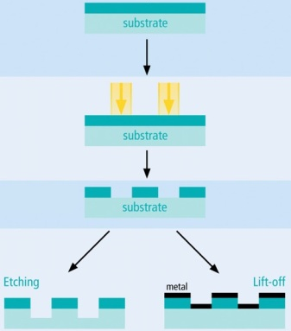
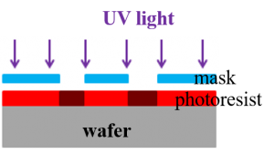
What is Nanofabrication?
Nanofabrication is a process of creating nanoscale structures
Nanofabrication is primarily a top-down process
Nanofabrication inherits the traits of microfabrication
Nanofabrication is primarily a planar process, can be obtain 3D shapes in some special cases
Lithography
Microscale process at CINT
Development
Nanoscale process at CINT
Nanofabrication has similarity with microfabrication but involves additional complexities due to reduced size
GaN 3D structures (Sandia)
Example of a planar process

Slide 5
Components of Nanofabrication
Process sample/substrate
Films processing
Oxides, nitrides, poly-Si, (ALD, CVD)
Additional treatments
RTA, annealing, passivation, protection
Sample preparation
Sample cleaning, mounting, transfer
Create patterns on polymer (photoresist)
Transfer pattern to sample/substrate
Lithography
e-beam, photo, imprint
Etch/Liftoff
Metal dep, dry etch, wet etch

Slide 6
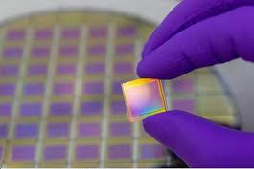
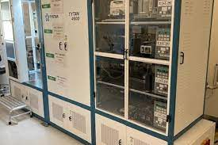
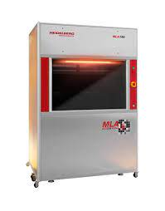
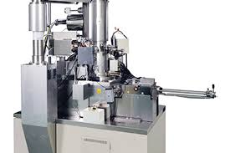
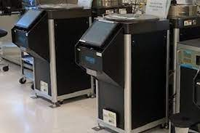
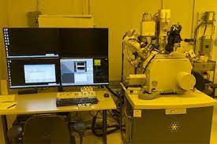
CINT cleanroom capabilities
Sample preparation
Wet benches, dicing tool, lapper, scribers, Plasma/UV/Ozone cleaning
LP-CVD, PE-CVD, ALD
Poly-si, dielectrics (SiO2, SiNx, Al₂O₃, TiO₂, & more)
CVD, ALD
Diced sample
Asher
LP-CVD
Lithography,
Patterning
Mask aligners, Laser writer (MLA), 100 kV EBL, 30kV EBL, FIB
Photolitho resolution ~ 1 um
EBL resolution down to 10 nm
Dry etch: Plasma milling, RIE, ICP, BOSCH
Chemistry: Cl₂, BCl₃, O₂, Fl, Ar, CH₄, SF₆
Well developed processes for Si, SiGe, GaN, GaAs, Diamond, & more
Etching
MLA
EBL
ICP
PVD dep Metal/Dielectric
E-beam evaporators, thermal evaporators, RF/DC sputterer
Materials: metals, alloys, dielectrics, semiconductors
Optical microscopes, SEMs, reflectometers, profilometer
Metrology
NanoSpec
SEM

Slide 7
Design of Fabrication
Define problem, set goals
Device needs
Theory and simulation
Test a concept/theory, prototyping
Identify parameters
Fabrication shape, size, resolution
Materials stack, compatibility, integration needs
Measurement requirements
Identify Fab process
Identify sample size, design pattern
Step by step process flow based on parameters
Identify steps that need testing/optimization
Feedback
Execute Fab
Work in parts: test/optimize unknown steps- can be parallelized, may need multiple experiments
Put them together once individual steps are tested
Measurement & Analysis
Inspect/measure sample at each step when possible
Use reference sample with primary sample to enable additional measurements

Slide 8
Identifying fabrication process flow
“Fail to plan is a plan to fail”
Design of Fabrication
(Parameters)
Inefficient but excellent process or efficient but ok process?
Available tools
Write down step by step fabrication process flow
Unoptimized process step?
Iterative optimization
# of test runs
Y
Feasibility
Example: How to design an optimal process?
Goal: fabricate 100nm wide 4 metal fingers with 150x150 um² contact pads which of the following is a desired approach?
Use EBL to write 100nm fingers (write time 1 min) & MLA to write contact pads (1 minutes)
Use EBL to write entire pattern (write time 1 hours)
Determine if the planned fabrication is feasible.
Tool limited: covering 2 inch wafer by dense array of EBL patterned 100nm features ➔ not possible
Policy restricted: 1um thick gold layer ➔ not allowed to deposit >300nm
Process limited: 50um deep plasma etched trench on sapphire ➔ very difficult

Slide 9
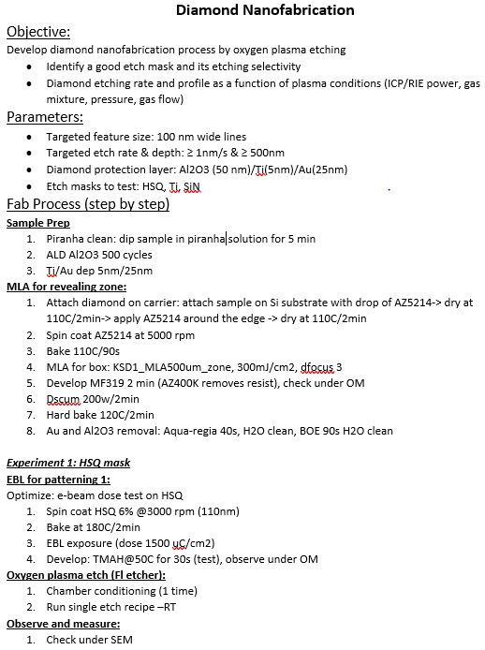
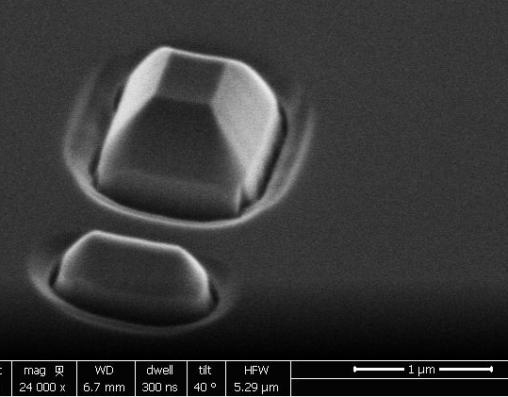
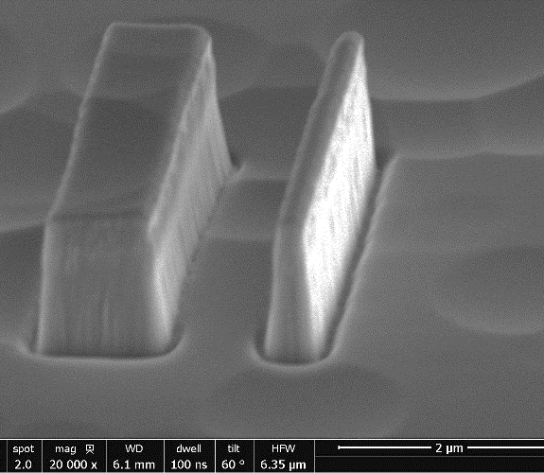
Executing design of fabrication
Detail fab plan example
Diamond etching
HSQ mask
HSQ mask
RIE/ICP = 100W/550W, O plasma
Result: etching but rough floor
RIE/ICP = 250W/550W, O plasma
Result: smooth profile but excessive lateral etch
RIE/ICP = 250W/550W, O-plasma
Result: good etch profile
Etch rate = 6nm/s
Etch depth = 1um
Ti:Diamond selectivity = 1:40
Ti mask

Slide 10
Optimization
Controllable: Resist thickness, dose, plasma power
Partially controllable: Photoresist edge beads
Uncontrollable: Tools dependent variation
Uncontrolled: humidity and its impact on photoresist film
Design of Fabrication
Define problem, set goals
Controlled variables
Uncontrolled variables
Identify parameters
Error
Yield
Feedback
Identify Fab process
Optimize process
Execute Fab
Unknown variables
Iteration
Measurement & Analysis
Optimization of a process by iteration

Slide 11
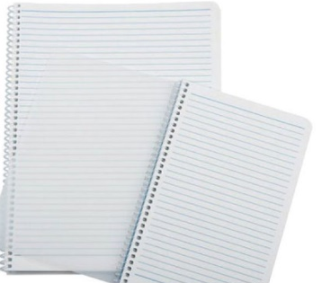
Documentation
Best practice: keep track of every small detail in the fab process
Fabrication experiment generates “multi-dimensional” data
Iterative optimization
Different batches
Optimize step 1
Batch 1
-----Data ---
-Process track
-Images
-Metrology data
Although you show one best image, your generate a lot of data in the process
Initial Fab Plan
Batch 2
Optimize step n
Available tools to manage data
Track process, data, docs,, PowerPoint
Track everything in one place
Track process, data, images
Cleanroom notebook to track process

Slide 12
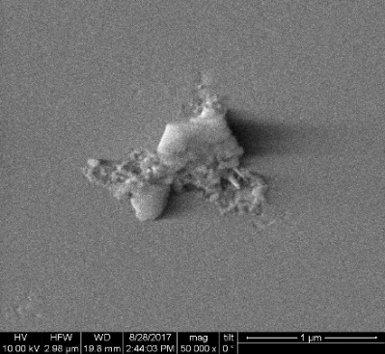
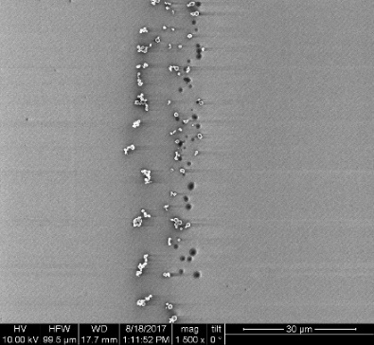
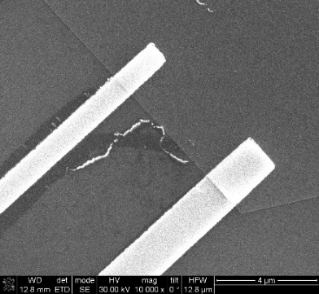
Common Fabrication Steps: Sample Preparation
Sample size: use dicing tool scriber to cut sample/ substrate to desired size
Sample cleaning
Samples with gunk
Metal particles
Leftover hydrocarbon after liftoff
Acetone airbrush, Methanol, IPA
Oxygen plasma (Barrel ash, ozone, LOLA)
Ammonia peroxide, piranha
Hydrocarbon/gunk removal:
Acetone airbrush (forceful), IPA
Ammonia peroxide (some), piranha (~all)
Metal particles removal:
HF, BOE (removes different oxides)
Hot bases e.g. KOH (removes Al₂O₃, SiO₂, attacks Si
Oxide removal:

Slide 13
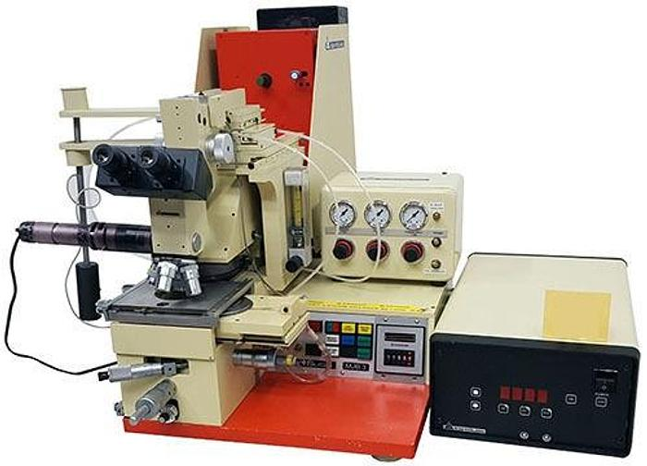
Common Fabrication Steps: Lithography
100 kV EBL
30kV EBL (SEM)
Resolution down to 10nm, high beam current (20nA)
Large area wafer scale patterning, stitching
Proximity correction included for extreme res patterning
Preferred samples size > 9mm
Resolution down to 30nm
No straight forward proximity correction
Smaller area EBL, no stitching
Choosing right tools
Dense patterns
Small samples
1mm long 250nm wide lines
Patterning contacts on 2D/1D nanostructures
MLA
Prototyping photolitho
Mask aligner
Maskless write from CAD
Resolution ~1um
Good speed
Image reversal photolithography process
Mask based photolitho
Uses mask to align and pattern optically

Slide 14
Common Fabrication Steps: Lithography- Choosing right tool
1mm long 250nm wide lines
Patterning contacts on 2D/1D nanostructures
Dense patterns
30kV EBL (SEM)
Small samples
100 kV EBL
Resolution down to 10nm, high beam current (20nA)
Large area wafer scale patterning, stitching
Proximity correction included for extreme res patterning
Preferred samples size > 9mm
Resolution down to 30nm
No straight forward proximity correction
Smaller area EBL, no stitching
Image reversal photolithography process
Prototyping photolitho
Mask based photolitho
MLA
Mask aligner
Maskless write from CAD
Resolution ~1um
Good speed
Uses mask to align and pattern optically

Slide 15
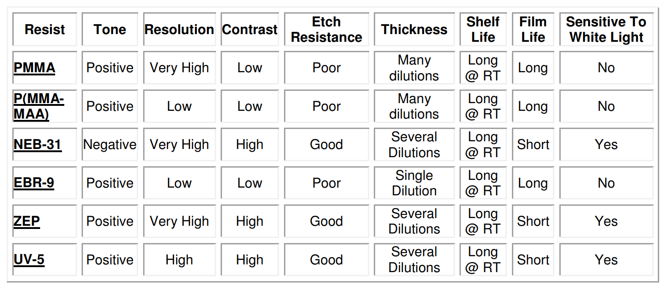
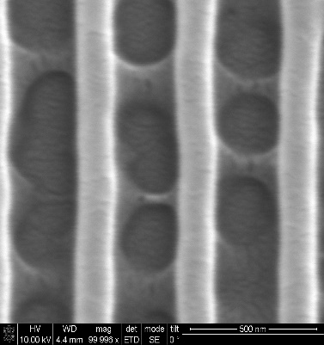
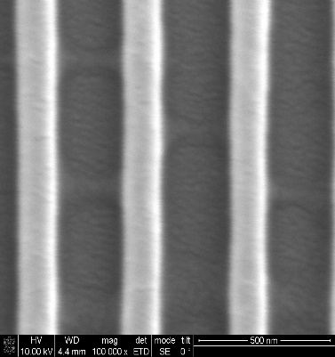
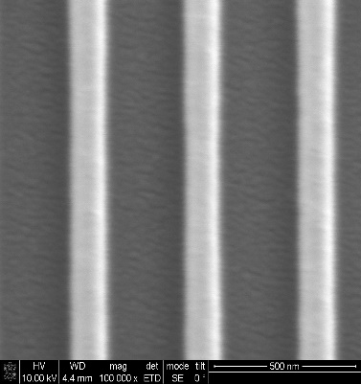
Common Fabrication Steps: Lithography
Typical Process
Create design. Free (and best) software: Klayout
Bake sample to remove moisture, coat primer to enhance adhesion if necessary
Spin coat photoresist single/multilayer, thickness > 2xmetal dep thickness for good liftoff
Correct proximity & test dose test for given patterns
Intuitive to design pattern
Python library to generate pattern
Some e-beam resists
Dose test: Increased dose

Slide 16
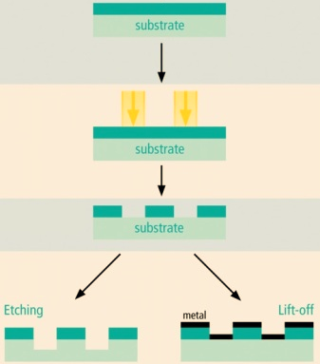
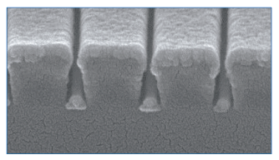
Common Fabrication Steps: Pattern transfer
Pattern transfer, a planner process, depends on the 3D parameters e.g., resist thickness, mask thickness, undercuts, lateral dimensions, etc.
Pattern transfer by liftoff
Clean developed pattern (e.g. Dscum, BOE, etc) for good adhesion and contact
Non-conformal metal dep, soak in acetone/PG remover
Things to consider
Typical adhesive metal layers: Ti, Ta, Cr
Dep rate, grains formation & film quality, heat transfer
Resist cracking & burn out due to excessive heating
Lithography
Development
Pattern transfer by etching
Pattern transfer by Liftoff

Slide 17
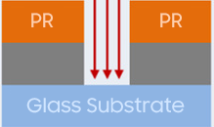
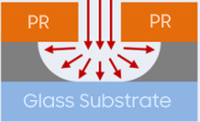
Common Fabrication Steps: Pattern transfer
Pattern transfer, a planner process, depends on the 3D parameters e.g., resist thickness, mask thickness, undercuts, lateral dimensions, etc.
Pattern transfer by etching
Polymer as a mask, metal mask, dielectric mask
Dry: Milling (physical) or reactive etching (chemical) -Anisotropic
Wet: Isotropic or crystal plane selective
Things to consider
Mask to material etch selectivity
RIE (highly anisotropic), ICP (high power plasma), or milling
Temperature and high energy plasma heating
Examples:
Cl-plasma for GaN, III-V semiconductor,
F-plasma for Si/Ge, BOSCH cycle for deep etching
Ion milling for metals
Wet etch: acid or base (oxides can be etched by both HF and hot bases), temperature, selectivity, safety
Plasma etch (aniso)
Wet etch (iso)
GaN in KOH
Wet etch (Crystal plane selective)

Slide 18
Troubleshooting
Error propagation and uncertainty in outcome
Sample prep
Patterning
Pattern transfer
Post process
Common troubleshooting steps
Track the note and identify if this is human error
Check if steps are exactly followed. Was there any step skipped?
Was there a change in tool such as recent maintenance, software updates?
Was the chemical used expired?
If issue not solved
Use reference samples created in each steps to inspect back to the process
Narrow down the process step(s) that might have caused the issue and re-test that step(s)
Literatures: incompatible chemistry, process
Subject Matter Experts (SME) help

